Slide 1
Improving Neural Networks
Transfer Learning
Data Augmentation
Techniques to Avoid Overfitting
Early Stopping
Dropout
Batch Normalization
Imbalanced Data
Hyperparameter Optimization

Slide 2
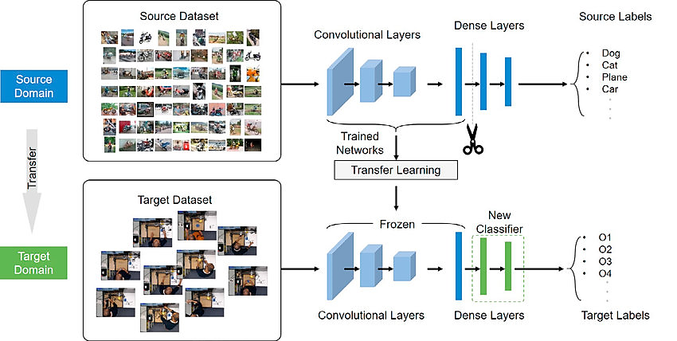
Transfer Learning

Slide 3
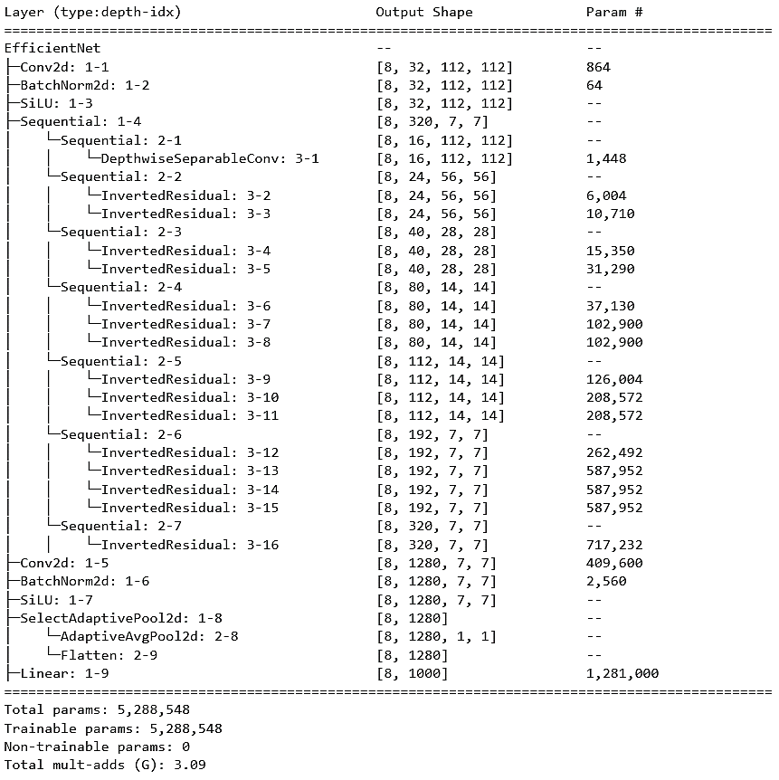
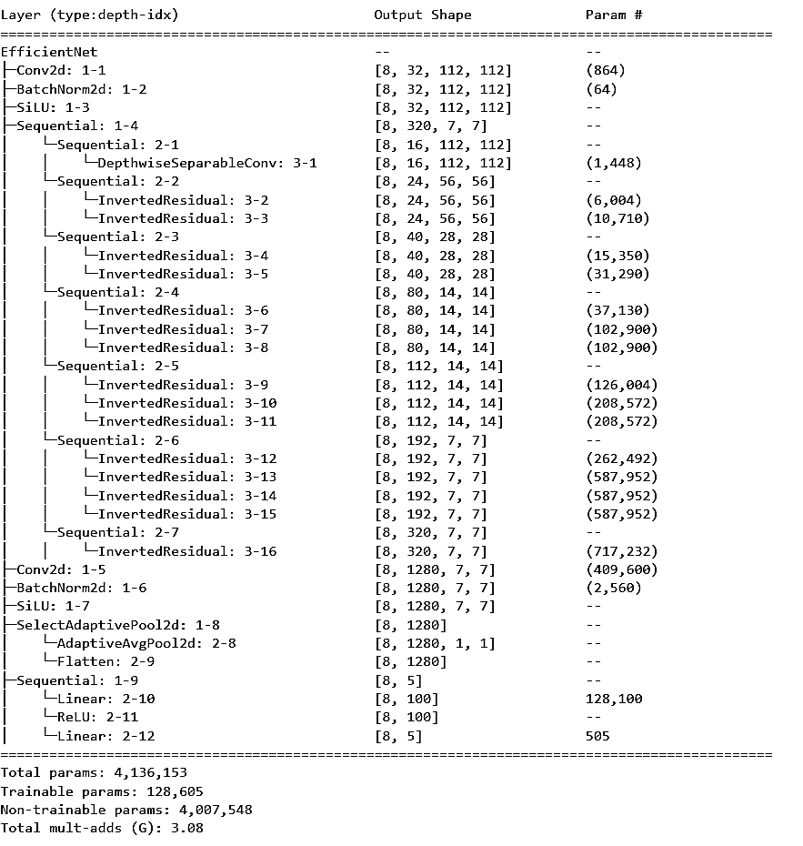

Slide 4
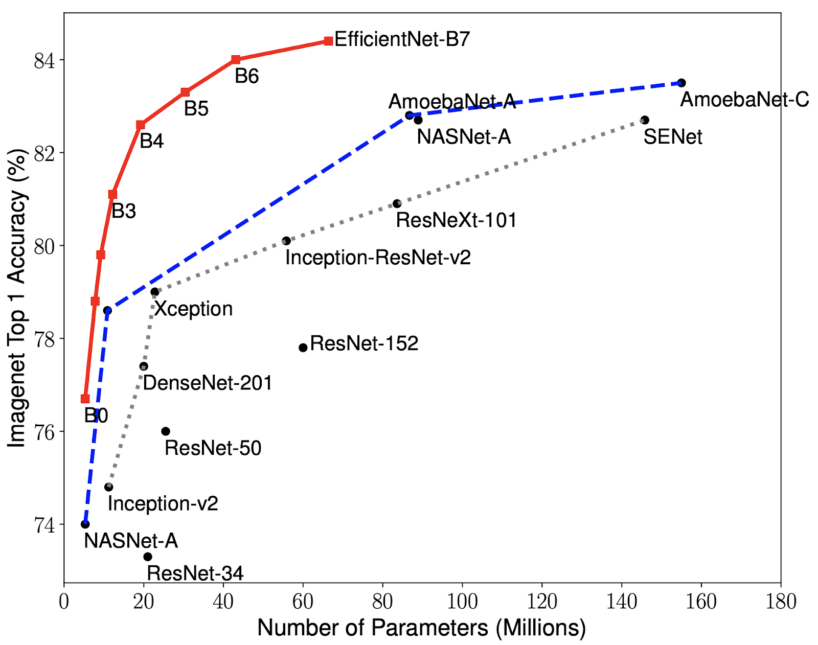
Which Model to Pick
Almost always, transfer learning must be our starting point. Do not try to build your own model, just use the one already built for similar applications.
Most of those models are trained on millions of everyday images. Thus, they are highly likely familiar with the type of images we have.
Leadership board changes frequently. Check out here. We don’t want to use billions of parameters for our simple problems. Pick something like EfficientNet, ResNet, VGG etc.
We will work with EfficientNet in our toy problems.

Slide 5
Data Augmentation
We usually need lots of images to train deep learning models. However, getting new images can be costly or not feasible in some cases.
However, we can do the following. In each epoch, we can feed modified versions of our images to our model. These techniques can be applied randomly or in a predetermined sequence to create a new version of an image. The modified images can then be used in addition to the original images to train the model.
By generating new, augmented versions of the training images, the model is exposed to more diverse data and can learn to generalize better.
Finding which augmentation works best is a formidable task for mortals like us. However, we can take advantage of Auto Augmentation concept. The idea is based on a paper from Google here.

Slide 6
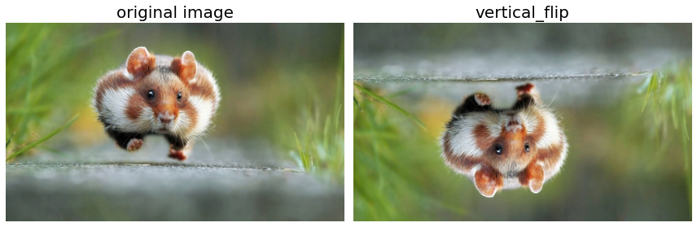
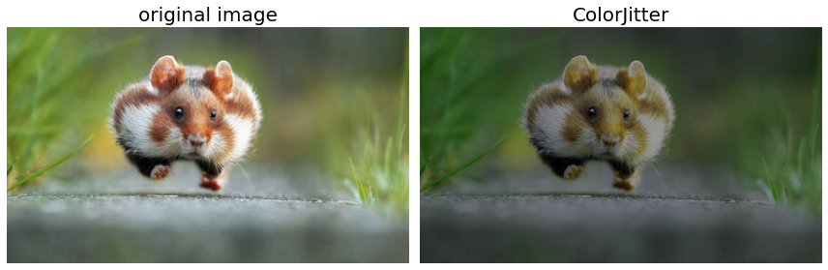

Slide 7
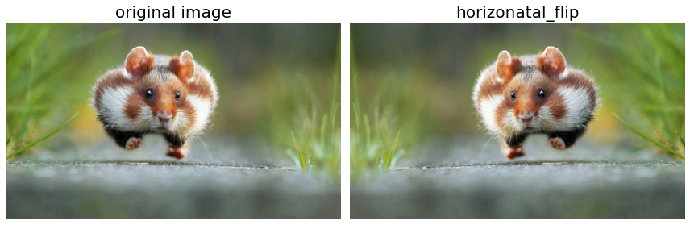
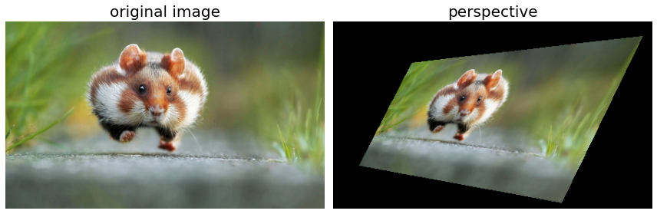

Slide 8
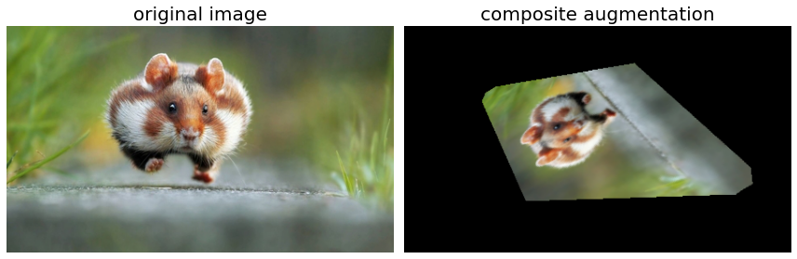
This a very common practice. We define a set of “random” augmentations and apply them to the data batch in a composite manner.

Slide 9
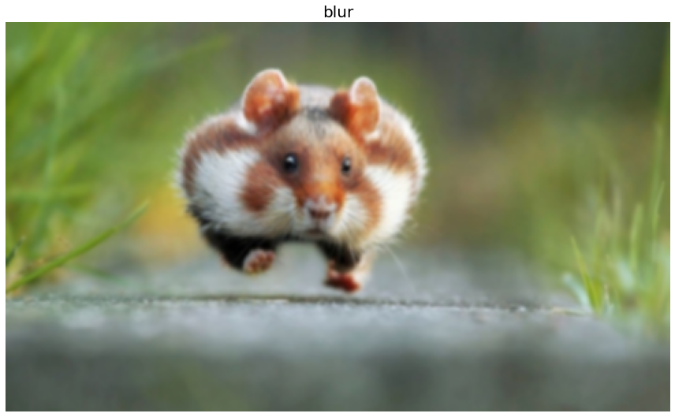
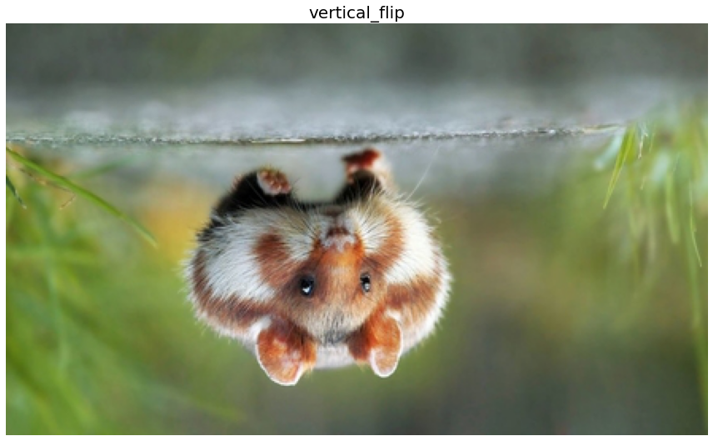
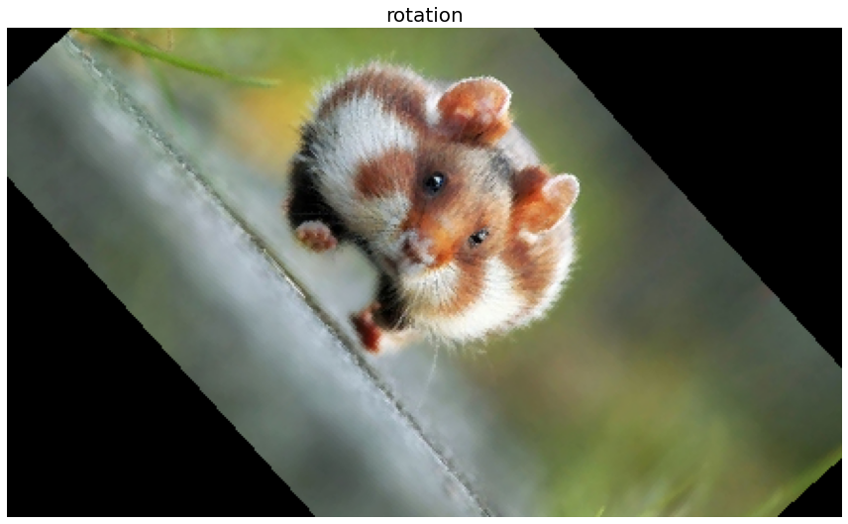
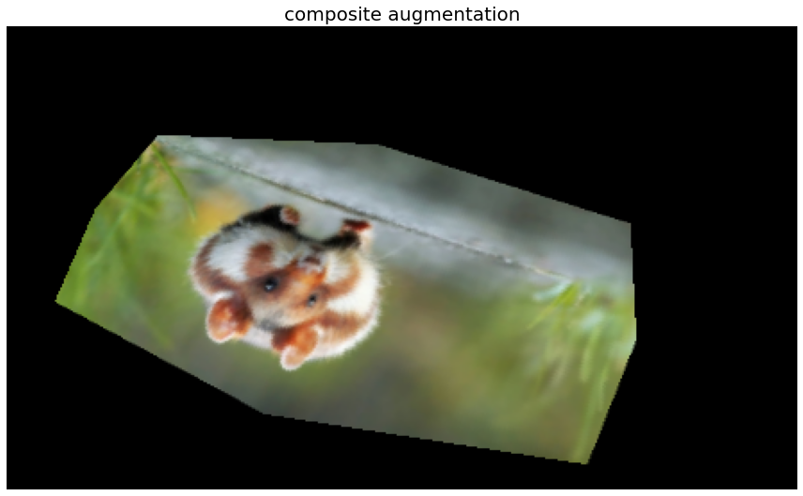
Epoch-1
Epoch-2
Epoch-3
Epoch-4
Chipmonk
Chipmonk
Chipmonk
Chipmonk
Model

Slide 10
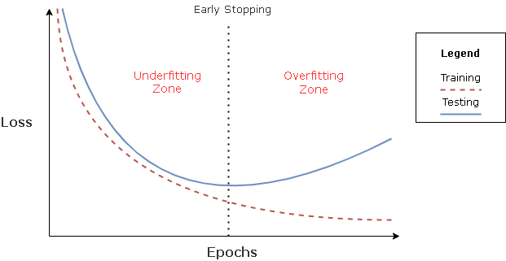
Overfitting
Model fits the training data too closely, but does not generalize well to unseen data.
Regularization is the name of techniques used in machine learning to prevent overfitting.
https://towardsdatascience.com/the-million-dollar-question-when-to-stop-training-deep-learning-models-fa9b488ac04d

Slide 11
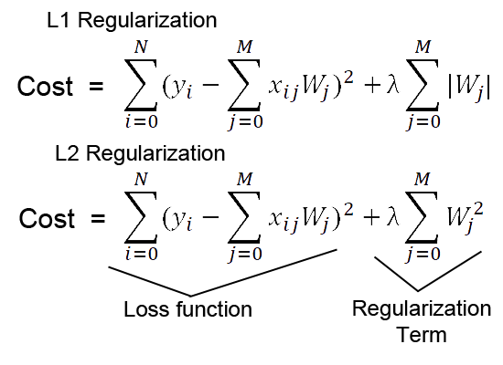
Weight Regularization: penalize the weights

Slide 12

Dropout: drop some nodes randomly
https://medium.com/@amarbudhiraja

Slide 13
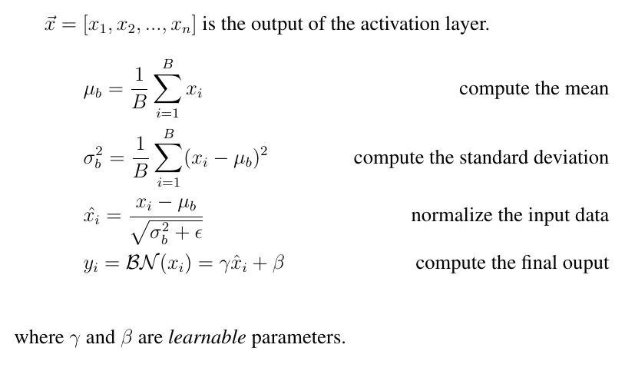
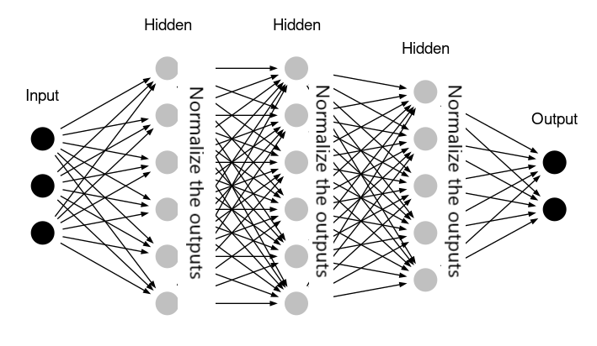
Batch Normalization
Almost all modern CNN architectures have Batch Normalization
Batch normalization improves the training speed, generalization, stability, and performance of deep neural networks.

Slide 14
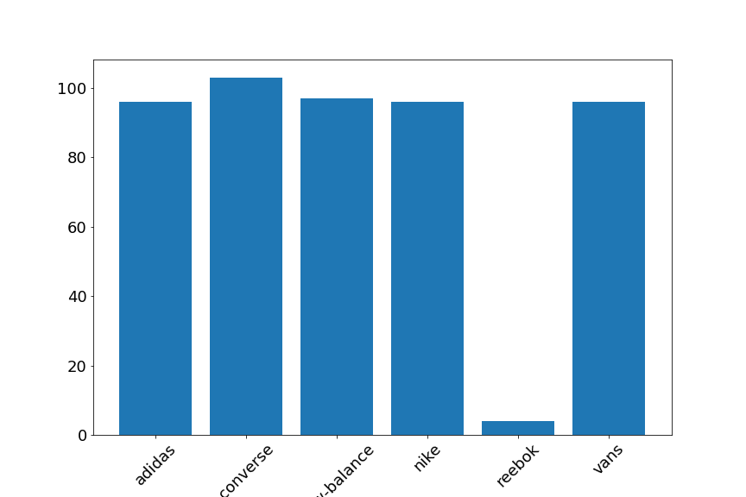
Imbalanced Data
Assume that, for some reasons, we could not find enough images for reebok brand. That means our model will likely to fail to recognize this class. In other words, recall for reebok class will be very low. You will have two assignments.
(1) Why is this issue relevant to real life problems? Give some concrete examples
(2)How do you handle this problem in our modelling pipeline? Implement in Pytorch domain.

Slide 15


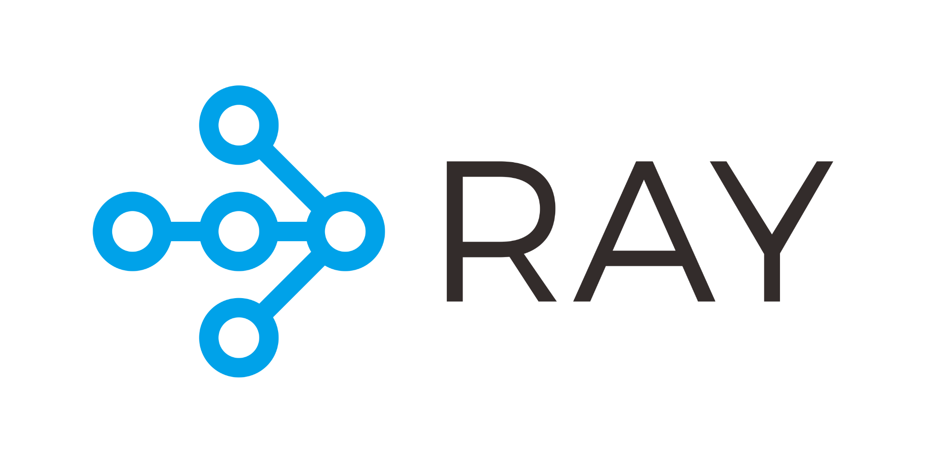
Hyperparameter Optimization
Roughly speaking, we have two kinds of parameters in deep learning
Learnable Parameters: quantities like weights and biases which we update in gradient descent.
Hyperparameters: the ones we set prior to training; learning rate, momentum, number of epochs, weight decay, batch size etc, model design etc.
Finding the optimal values for those parameters can be a challenging task and it is an active research field.
There are quite a bit libraries we can adopt into our modelling pipeline. We will use Optuna.

Slide 16
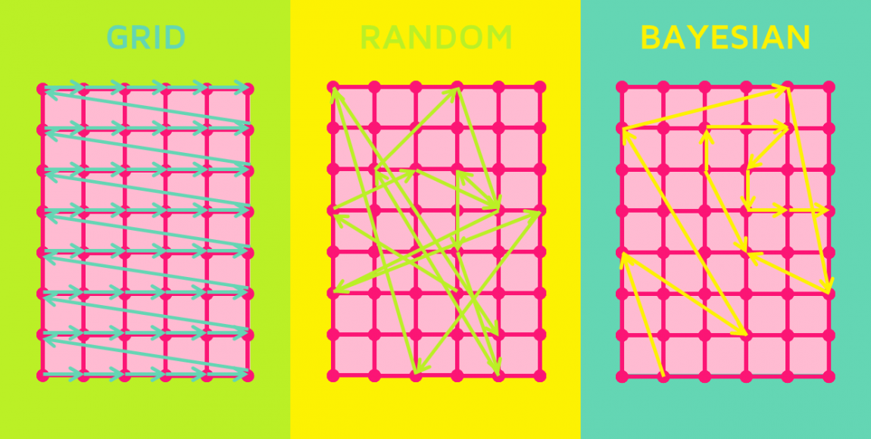
Grid Search: the model is trained and evaluated using each combination of hyperparameters in the grid. If we try 4 options for three parameters, we have a total of 4^3=64 options to try!
Random Search: parameters are sampled randomly from a defined search space, and the model is trained and evaluated using each combination of hyperparameters. Usually better than grid search.
Bayesian Optimization: probabilistic model is built based on the performance of the model on different hyperparameter settings. The probabilistic model is used to guide the search for the optimal hyperparameters, by iteratively selecting hyperparameters based on the model's prediction of the performance.
We will implement Bayesian Optimization using Optuna.
https://quantdare.com/what-is-the-difference-between-parameters-and-hyperparameters/

